Slide 1
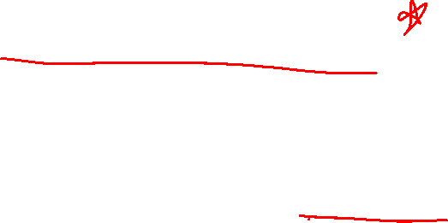
Section 2.6 Limits at Infinity; Horizontal Asymptotes
Lecture 1
Old idea, new foundation

Slide 2

Homework Submission to Canvas
Preview of section
Skim the section in text and write a short paragraph summary.
Give a bulleted list of all important definitions, theorems, and formulas without details.
Notes on video lectures
Take notes on everything written on slides including all details, worked examples, on-own activities, as well as your own thoughts and questions.
Try on-own activities first, then write down provided solution next to it for comparison.
Worked examples from the text
Write down the problem and attempt without looking at the solution.
Use the solution to write the best explanation you can.
Solutions to textbook exercises
Model approaches and explanations given in the video lectures and textbook examples.
Final reflection of section
List the key takeaways to remember as a bulleted list.
Video reflection (for some sections)
Write a 1 paragraph reflection on the video discussing what you found most interesting or useful.

Slide 3
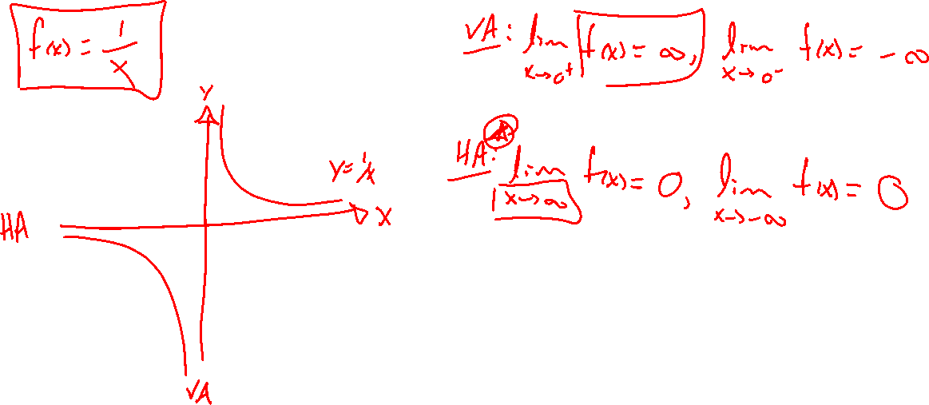
Motivation: Basic example
Notes:
F(x) = 1/x, know VAs. Guess what the HA version should be.
Notation easy, how to think about it carefully.

Slide 4
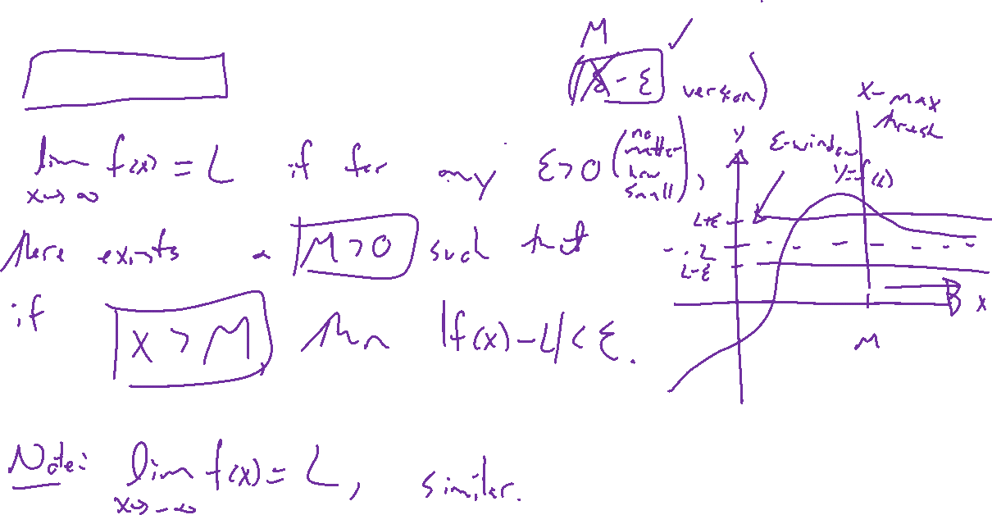
Definition: Limits at infinity
Notes:
Lim_{x \rightarrow \infty} f(x) = L if....
-\infty similar, think about the \delta - \epsilon version if you like.
Draw picture. Note two directions, don't have to agree.

Slide 5
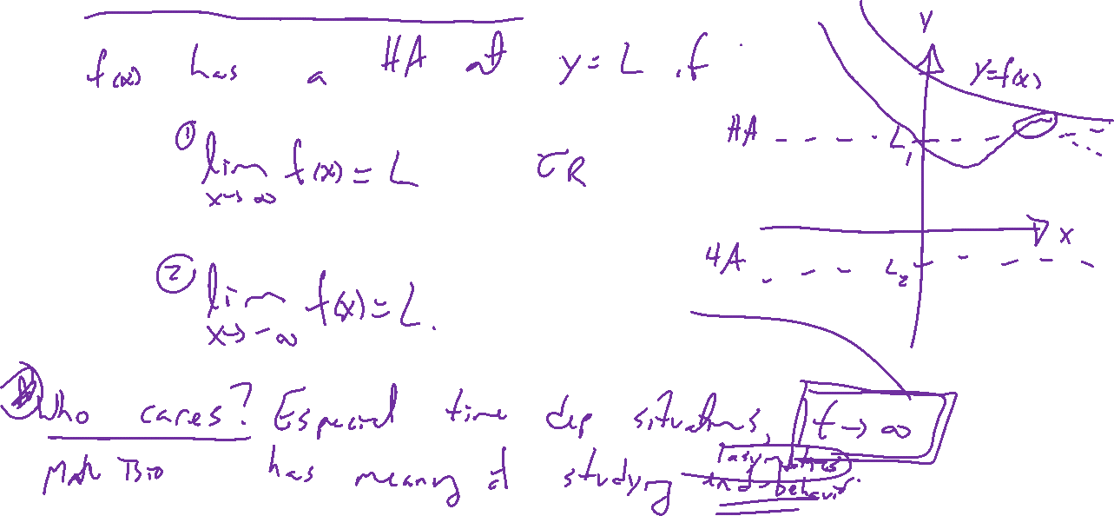
Horizontal asymptotes defined
Notes:
Careful definition to amend previous intuition.
Think of this as end-behavior of some time dep function. Sometimes most interesting case.
UWL ash tree, ecology population asymptotics

Slide 6
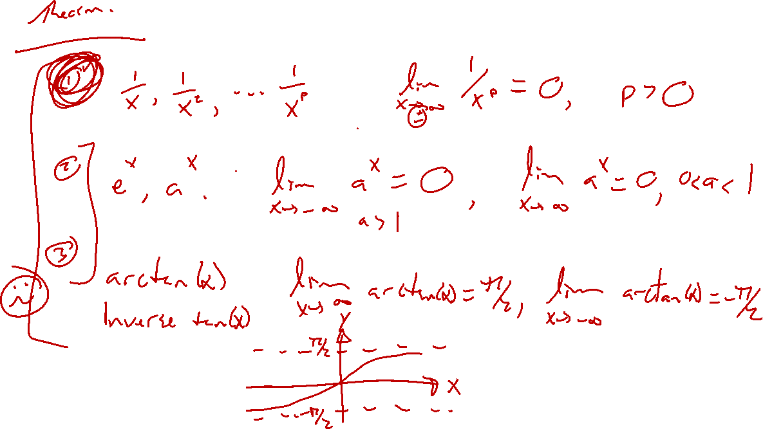
Examples: Basics
Notes:
1/x^r, r>0, look at x \rightarrow +- \infty
E^x, a^x
Arctan(x)
Check in desmos

Slide 7
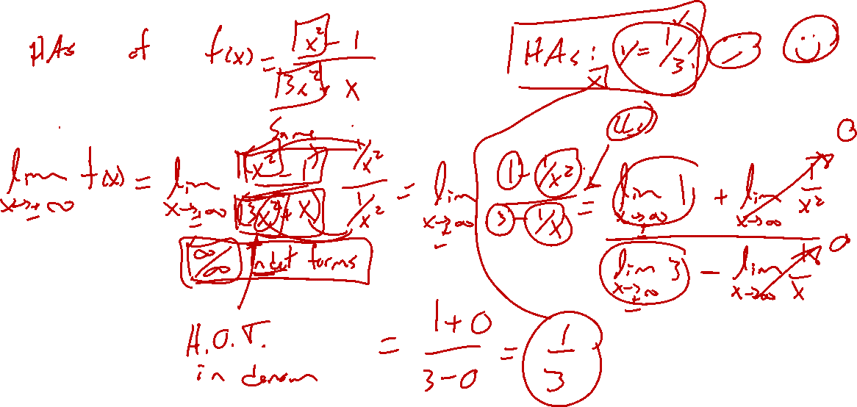
Example: Return of rational functions
Notes:
Random rational function. Think back to previous rules from algebra. Divide by HOT in denom.

